Slide 1
BASIC APPROACH
LEAD SCORING CASE STUDY

Slide 2
Data Inspection
Shape,
Info,
Describe,
Dtypes,
Duplicates
Null Value Counts

Slide 3
Data Cleaning and Preparation
Checking Null Percentages
Dropping columns with high null percentages
Checking for outliers
Imputing cols with low null percent. (mean, median, mode)

Slide 4
Data Cleaning and Preparation
Treat cols having “select” value
Checking no. Of unique values in columns. (nunique())
Cols with 1 unique value
Cols with 2 unique value (map categorical ones)
Cols with more unique values (Create dummies)
pd.get_dummies()
a b c
0 1 0 0
1 0 1 0
2 0 0 1

Slide 5
Basic Check and EDA
All missing values handled
Atleast 60-70% rows retained or not
Check Lead conversion rate (about 30%)
Basic EDA: Barplots, heatmaps, displots

Slide 6
Model Building
Test-Train split (30-70)
Scaling after split
Use RFE to select about 15-20 variables.
Manual elimination based on P-values and VIF values.
Heatmap to check Multicolinearity
Prediction of probabilities
Plotting ROC curves and selecting optimal cutoff

Slide 7
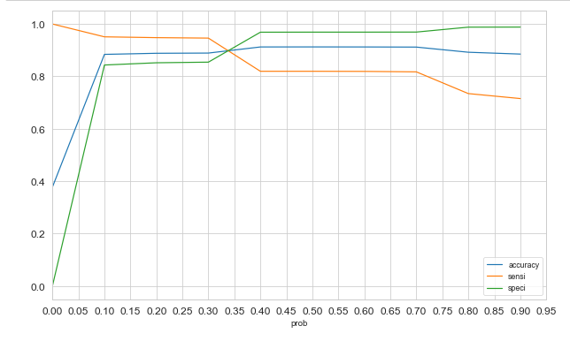

Slide 8
Model Building
Optimal cutoff by taking various cutoffs and observing the metrics
Prediction of classes.
Metrics on Train Data (Sensitivity and Specificity)
Confusion Matrix.
Metrics on Test data (Sensitivity and Specificity)
Difference should not be high.

